Slide 1
Eventual Consistency Today: Limitations, Extensions and Beyond
Peter Bailis and Ali Ghodsi, UC Berkeley
Presenter: Yifei Teng
Part of slides are cited from Nomchin Banga

Slide 2
Road Map
Eventual Consistency: History and Concepts
How eventual is eventual consistency?
Programming eventual consistency
Stronger than eventual
Conclusions
Notes:
Here is everything we will cover.

Slide 3
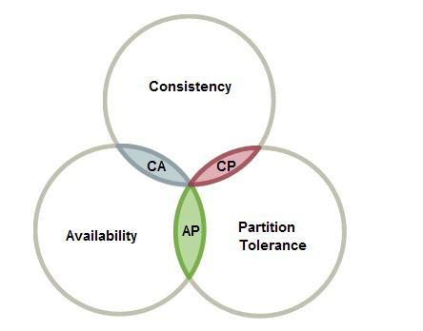
CAP Theorem
Maintaining single-system image has a cost
Note that you can’t “sacrifice” partition tolerance
Consistency-availability tradeoffs
Consistency-latency tradeoffs
Notes:
CAP theorem is already introduced in previous presentations. It states that a distributed system requiring high availability cannot guarantee the illusion of single system image in the presence of network partitions.
Given the CAP impossibility result, distributed database designers sought weaker consistency models that would enable both availability and high performance. The ideal model is eventual consistency.

Slide 4
Eventual Consistency
“…changes made to one copy eventually migrate to all. If all update activity stops, after a period of time all replicas of the database will converge to be logically equivalent: each copy of the database will contain, in a predictable order, the same documents; replicas of each document will contain the same fields.”
Notes:
One of the earliest definition comes from a 1988 paper stating that

Slide 5
Compare SSI and Eventual Consistency
The predictable order will not necessarily correspond to the execution order
Order confusion
Eventual consistency doesn’t specify windows before converge
Arbitrary value
SSI provides eventual consistency, but not vice versa
The “eventual” is immediate
Notes:
Although eventual consistency guarantees that all replicas eventually converge, and each copy will contain the same documents in predictable order. However, eventual consistency doesn’t provide SSI semantics.

Slide 6
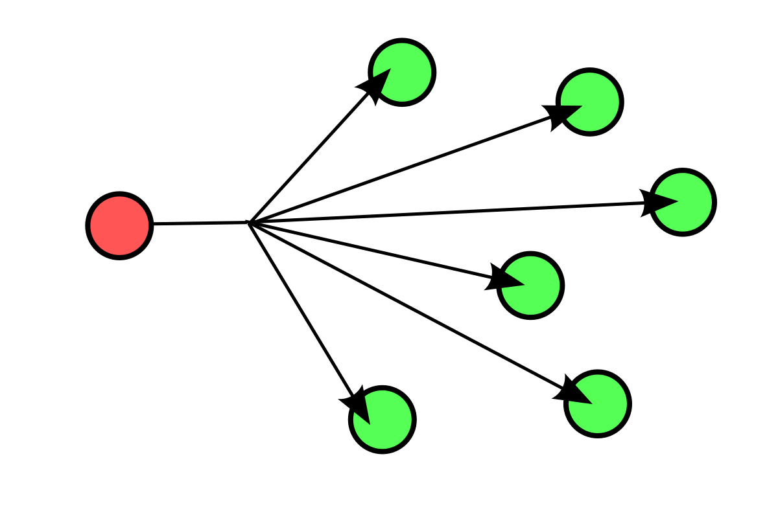
Anti-entropy
Anti-entropy policy
Boardcast is the simpliest one
Choose a winning when concurrent writes happen
Asynchronous process
Non blocking anti-entropy
Broadcast
Notes:
To ensure convergence, replicas must exchange information with one another about which writes they have seen. This process is often called anti-entropy.

Slide 7
Great Properties
Easy to implement:
does not require writing difficult “corner-case” code to deal with complicated scenarios
All operations complete locally:
Low latency
Systems can control the frequency of anti-entropy
Notes:
The eventually consistent system has some great properties.

Slide 8
Safety and Liveness
Safety – nothing bad happens
every value that is read was, at some point in time, written to the database
Liveness – all requests eventually receive a response
Eventual Consistency is purely a liveness system.
Replicas will converge, but there are no guarantees with respect to what happens
Notes:
While eventual consistency is easy to implement, the definition leaves some holes. Such as what is the eventual state? And if replicas are not converged, what guarantees can be provided? These questions stem from two kinds of properties possessed by all distributed systems: safety and liveness.

Slide 9
Metrics and Mechanisms
Metrics
Window of consistency: How long for a write to be available to read?
Version: How many version old will a returned value be?
Mechanisms
Measurement: How consistent is a store under the workload now?
Prediction: How consistent will a store be under a given situation?
Notes:
While eventually consistent stores don’t promise safety, they do provide safety in practice. That’s why they’re widely used. We have some techniques to quantify eventual consistency.

Slide 10
Probabilistically Bounded Staleness (PBS)
Provide an expectation of recency for reads of data items
100 milliseconds after a write completes, 99.9 percent of reads will return the most recent version
85 percent of reads will return a version that is within two of the most recent
Rate of anti-entropy
Network Delay
PBS
Expected consistency
Local process time
Notes:
Probabilistically Bounded Staleness, we say PBS, is a model used to measure and predict the consistency of a given data store.

Slide 11





Eventual Consistency is “good enough
13.6ms
202ms
500ms
200ms
12s
Notes:
Here are the window of inconsistency of some data stores. They are frequently consistent within tens or hundreds of milliseconds.
So eventual consistency is usually good enough for applications.

Slide 12
Programming Eventual Consistency
Compensation: a way to achieve safety retroactively
Restore guarantees to users
Evaluate the benefit
B: The benefit of weak consistency
C: Cost of each compensation Maximize B - CR
R: Rate of anomalies
Notes:
As mentioned before, eventual consistency doesn’t provide safety guarantee. When the system is in a wrong state, you have to compensate for any incorrect action taken during the period.

Slide 13
Compensation by Design
Compensation is error-prone and laborious
Some researches provide compensation-free programming
CALM theorem: consistency as logical monotonicity
ACID 2.0: associativity, commutativity, idempotence, and distributed
CRDT: commutative, replicated data types

Slide 14
CALM (Consistency as Logical Monotonicity)
Monotonicity: compute an ever-growing set of facts and do not ever “retract” facts that they emit
A program satisfies CALM can always be safely run on an eventually consistent store.
Monotonic operations
Initializing variables, add set members, and testing a threshold
Non-monotonic operations
variable overwrites, set deletion, counter resets, and negation

Slide 15
ACID 2.0
Associativity, commutativity, idempotence, and distributed
Commutative and associative program can tolerate message re-ordering
Idempotence allows the use of at-least-once message delivery
Applying these design patterns can achieve logical monotonicity
Notes:
The design pattern captured by CALM sometimes refers to as ACID 2.0. Which means associativity, commutativity, idempotence, and distributed. Associativity means that you can apply a function in any order, Commutativity means that a function’s arguments are order-insensitive, Idempotence means you can call a function on the same input any number of times and get the same result. Distributed is only a placeholder acronym.

Slide 16
CRDT (Commutative, Replicated Data Types )
CRDTs embodies CALM and ACID 2.0 principles
Any program that correctly uses CRDTs is guaranteed to avoid any safety violations.
A key property is separating data store and application-level consistency concerns.
Enjoy strong application level consistency
And the benefits of weak distributed read/write consistency
G-Counter is a typical example

Slide 17
Stronger than Eventual
Compensation requires dealing with inconsistency outside of systems
CRDT limites the operations an application can employ
Research shows that no consistency model stronger than causal consistency is available in the presence of partitions
Causality can be added to eventual consistency
Notes:
While two ways to achieve eventual consistency, compensation and CALM/ACID2.0, they have shortcomings of their own.

Slide 18
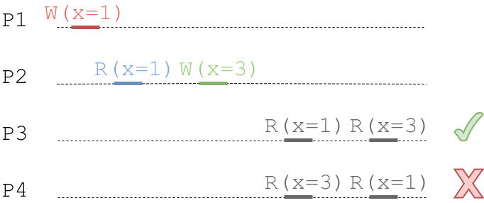
Causal Consistency
guarantees each process’s write are seen in order, transitive data dependencies hold
Notes:
If event A causes event B, we say A and B are causally related. Causal consistency means that all processes in the system agree on the order of the causally related operations.

Slide 19
Pushing the Limits
Causality
COPS, Eiger provide causality with low latency and high availability.
Many eventual consistent applications can be augmented with causality
Re-architecting weak isolation databases in distributed environment
Keep the same ACID properties
High availability

Slide 20
Recognizing the Limits
A fundamental cost to remaining highly available and low latency
Staleness guarantees are impossible in a highly available system
give me the latest value
Cannot maintain arbitrary global correctness constraints
“create an account with ID 50 if the account does not exist”
Notes:
While eventual consistency is powerful, it cannot provide several properties.

Slide 21
Conclusions
Eventual consistency improves availability and performance at the cost of guarantees
Eventual consistency not perfect for every task, but good enough for many applications.
And eventual consistency will be admired in the future because of its performance and availability

Slide 22
Thanks You!

